Slide 1
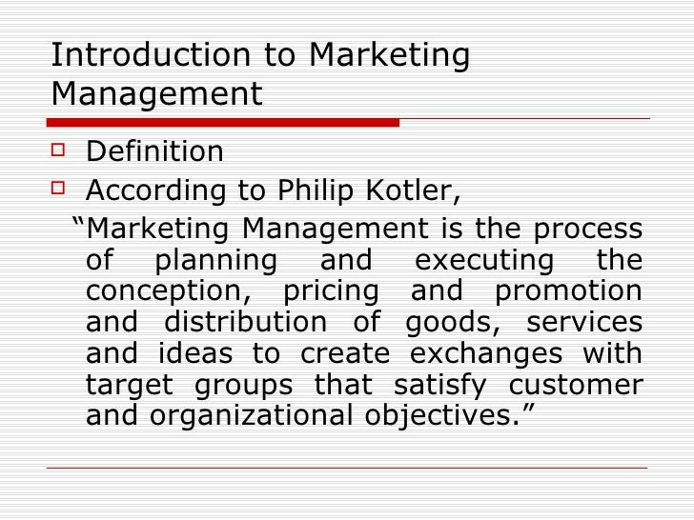

Slide 2
Scope of Marketing
Creating, promoting & delivering goods & services to customers.
Decision related to size, color, design packaging etc of product & nature of service.
Customer satisfaction & after sales services.

Slide 3
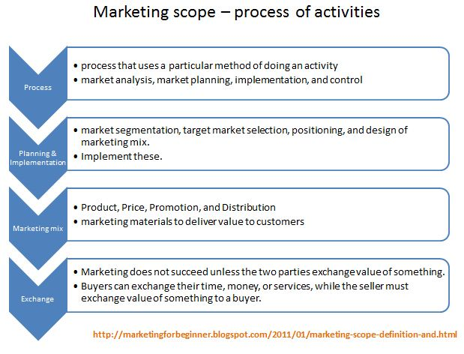

Slide 4
Objectives of marketing
Provide better quality product.
Create demand of product.
Increase customer satisfaction.
Create goodwill & positive brand image.
Generate sales volume & profits.

Slide 5
Market Orientation
Market orientation is defined as an approach of a business entity that identifies the wants and needs of its target consumers and manufactures specially designed products to satisfy them. It is the way that an organization deals with its potential as well as current consumers.
The business entities that have adopted this strategic concept are communicative and vibrant and are at the forefront to seek new ways to meet specific demands.

Slide 6
Meaning of market orientation
Market orientation is about adopting a customer-centred approach for designing and creating products. It includes detailed research to understand the view, personal preferences, and primary concerns of the target consumers within a specific product category.
Sometimes the business entities use data analysis to reveal new trends and desires of its customers because knowledge is power and it proves beneficial in anticipating the demands and improvising their product specifications to match the desire of its target customer.

Slide 7
A market-oriented company ensures that there is a continuous demand for its products and services. Adaptability is the key in these competitive times. Instead of convincing customers to try something new, the companies are changing their product portfolio to suit the consumer requirements.

Slide 8
For example, if a restaurant finds that most of its customers are interested in eating pizza, it will try to create and serve them as per the demands of its customers and not try to convince them to try a burger.

Slide 9
Characteristics of market orientation
A market-oriented organization gives emphasis on survey and research and finds out about the particular needs and wants of its target customers. They want to know the opinion of their consumers so that they can determine what the customer is looking for in products and services.
Once the market-oriented company is aware of the demands and wishes of its customers through the feedbacks, they try to exceed them by offering the best possible product.
Building anticipation amongst its customers through promotion and marketing campaigns is a simple way to garner customer attention.

Slide 10
For example, companies like Amazon have anticipated the needs of their customers and tried to make their plans around it. It knows that most of the consumers do not like to pay the delivery charges. Hence they have offered various options for free or minimum payment delivery.
It has started a scheme Amazon Locker, self-service pickup boxes, for clients that cannot be at home during the delivery time.

Slide 11
The numerous advantages of market orientation are as follows-
It is the customers that help the business to thrive and grow. The market orientation helps the company to attract further customers as the products are in sync with the demand and needs of its customers.
A customer-centric approach helps to avoid wasted resources as the company is already aware of the needs and wants of its customers.
The market orientation approach helps the business entity in garnering assured profits through credible sales figures

Slide 12
The disadvantages of market orientation are as follows
The market-oriented companies are more concerned about meeting the desires of their customers than creating a new and innovative product. It lacks motivation and thus loses sight of potential innovative breakthroughs.
It is not easy to create and target campaigns that can meet the demand of all its customers

Slide 13
Market research is a costly business and has a direct impact on the revenues
Without ant product differentiation it becomes difficult to stand its ground in the face of competitive rivals
Consumer want is not a fixed thing as it can change with the drop of a hat. A business entity might find it hard to keep up with those ever-changing needs and wants.

Slide 14
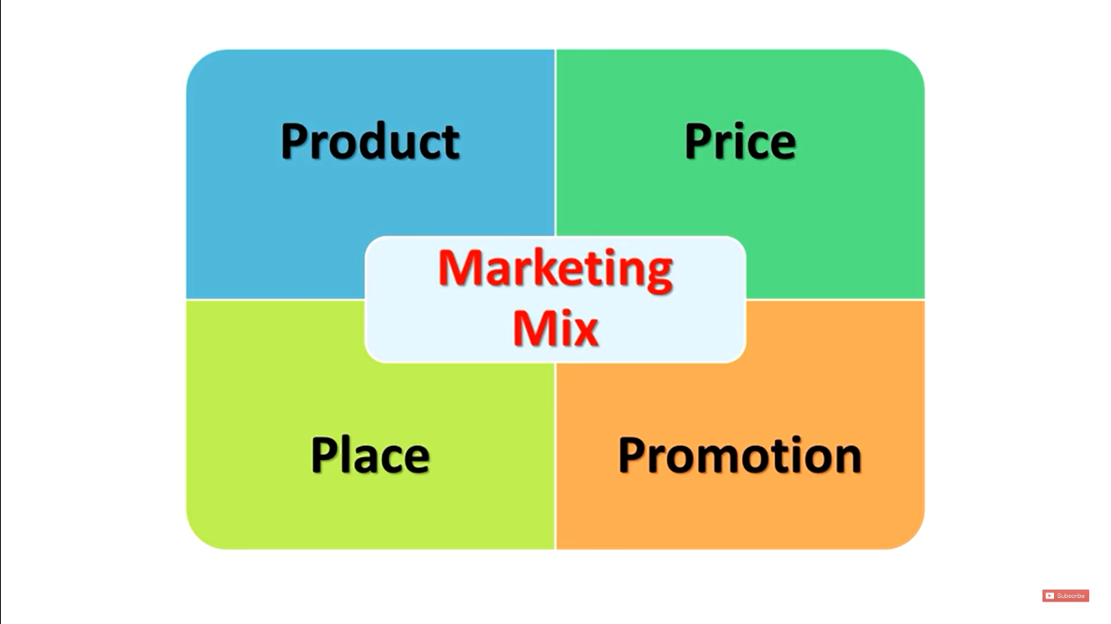
Marketing Mix

Slide 15
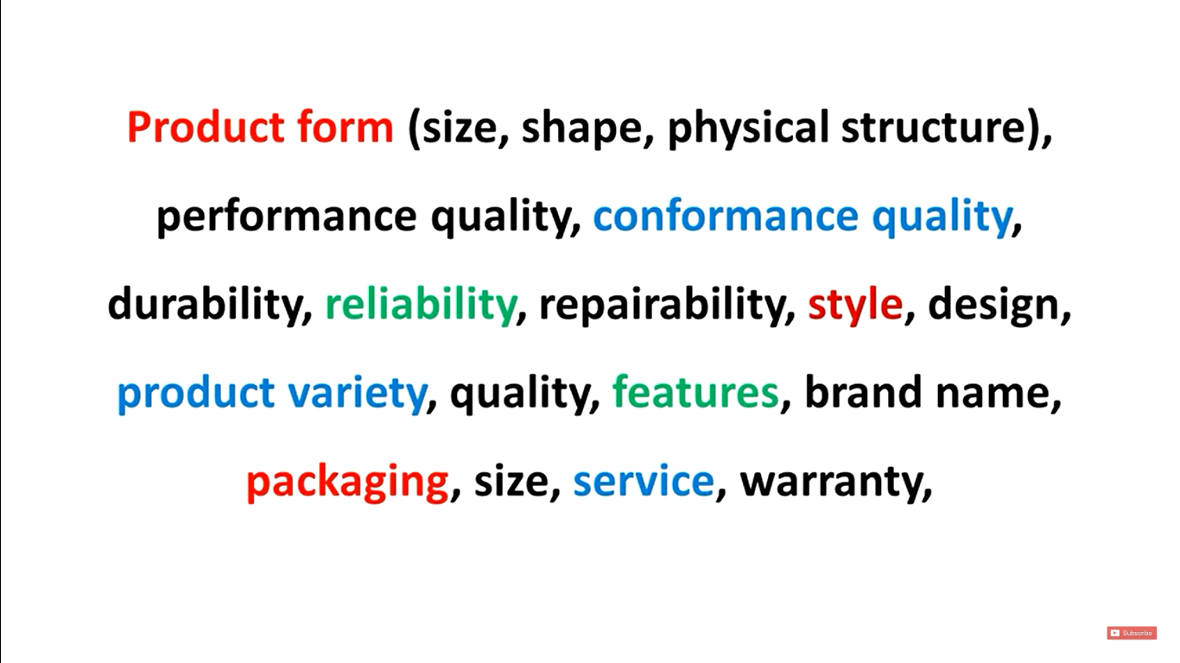
PRODUCT

Slide 16
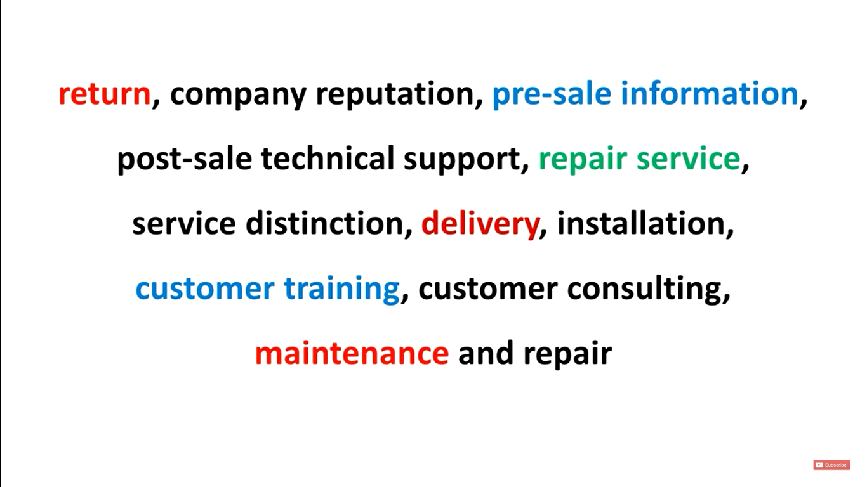

Slide 17
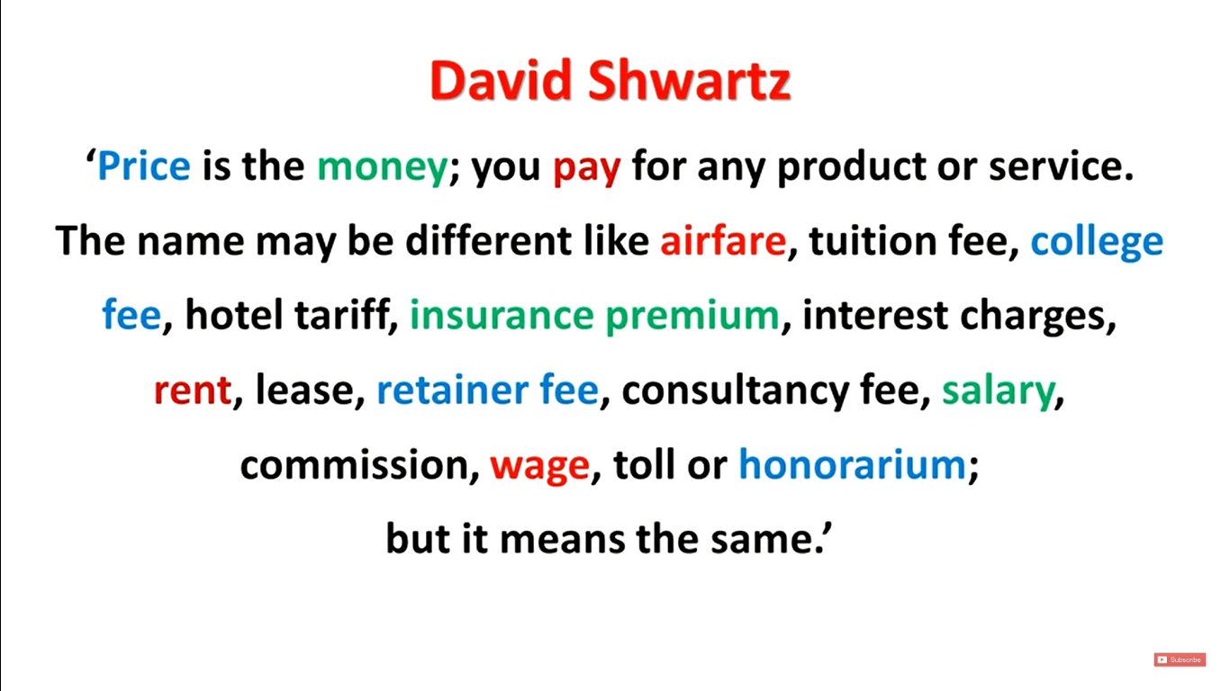
PRICE – Variable

Slide 18
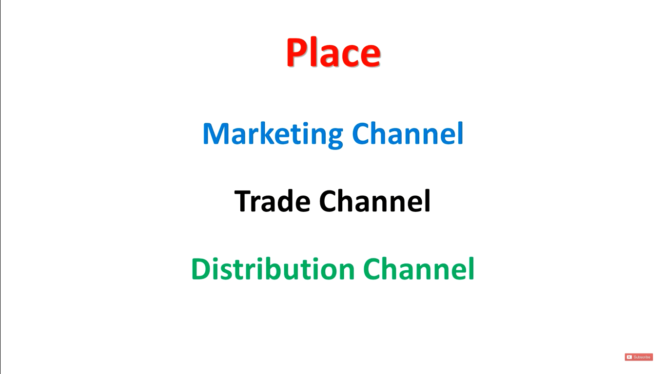

Slide 19
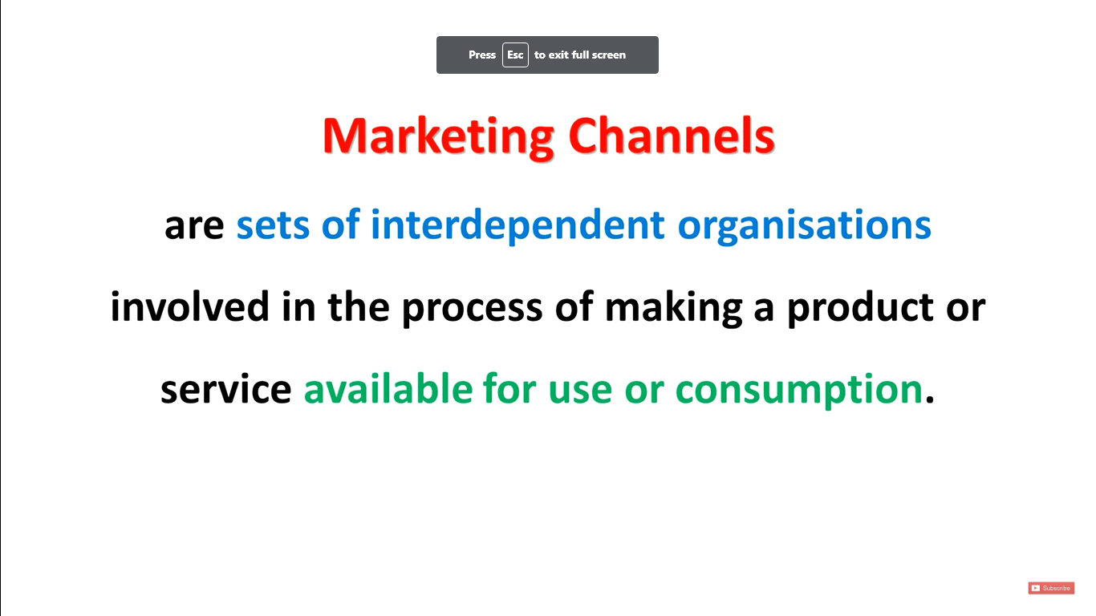
E.G- Communication channels, service channels

Slide 20
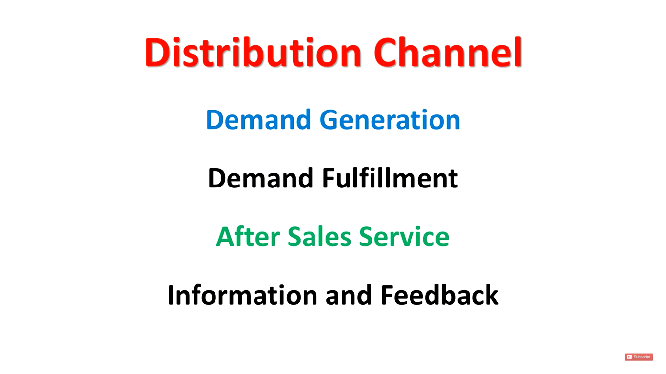

Slide 21
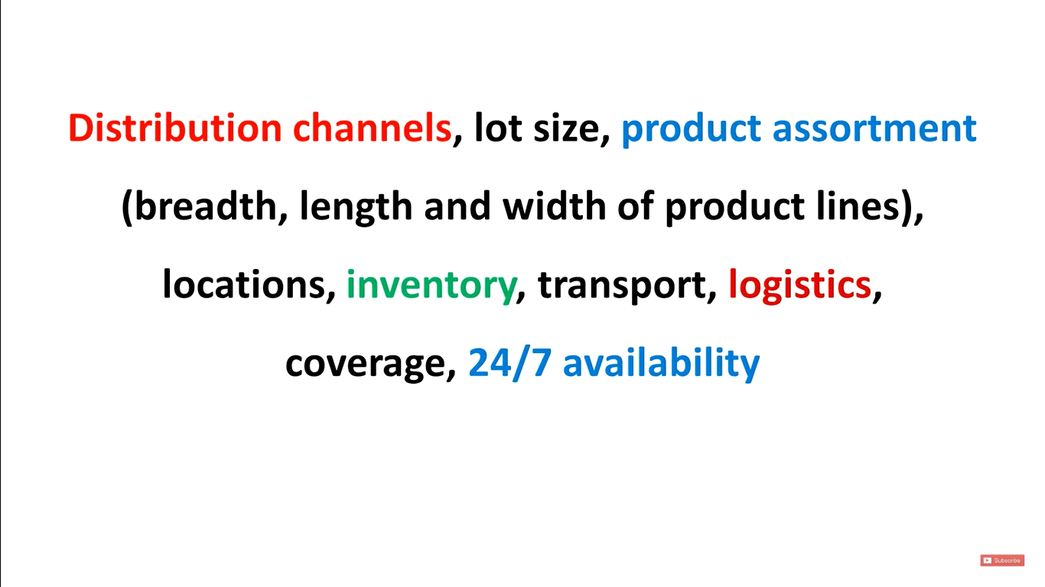

Slide 22
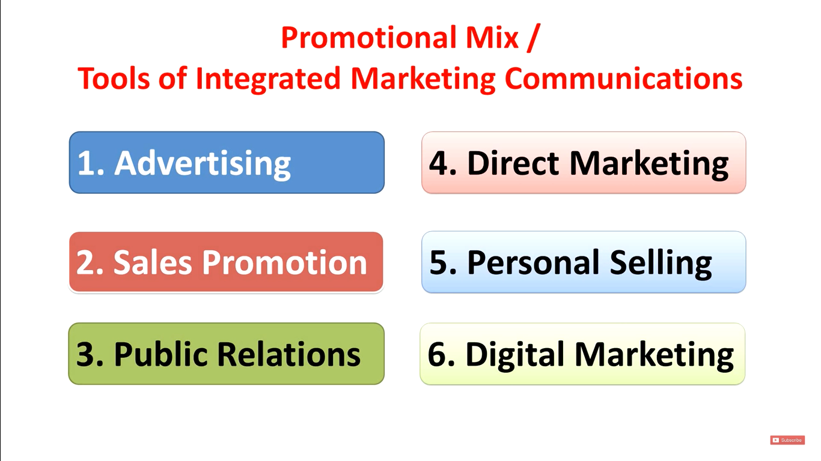
PROMOTION

Slide 23
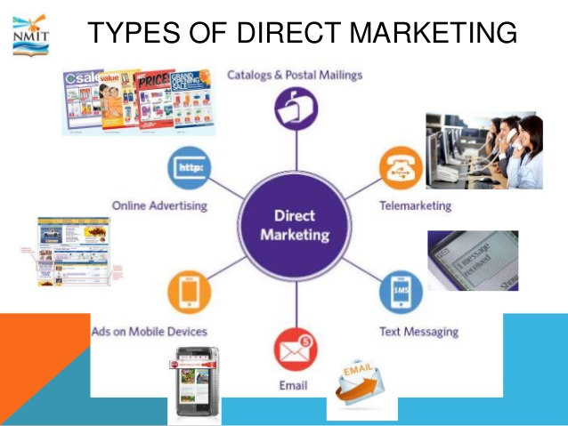

Slide 24
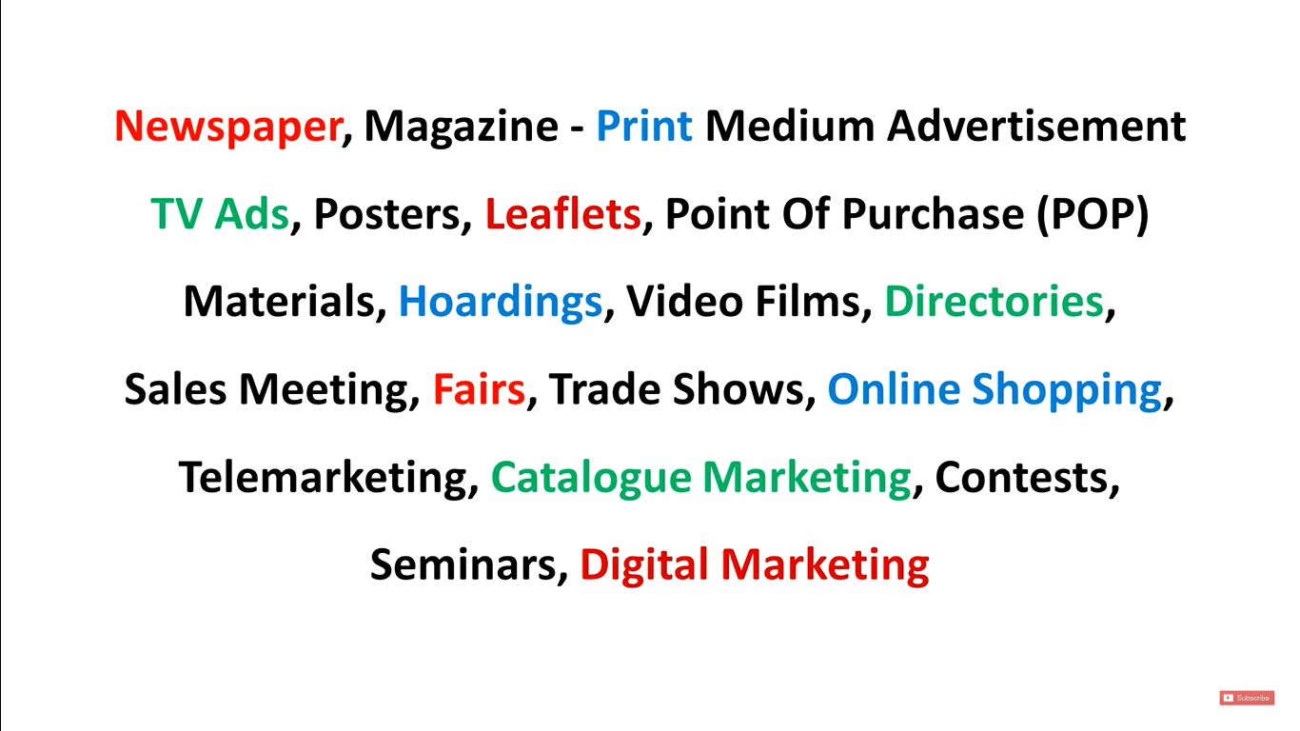

Slide 25
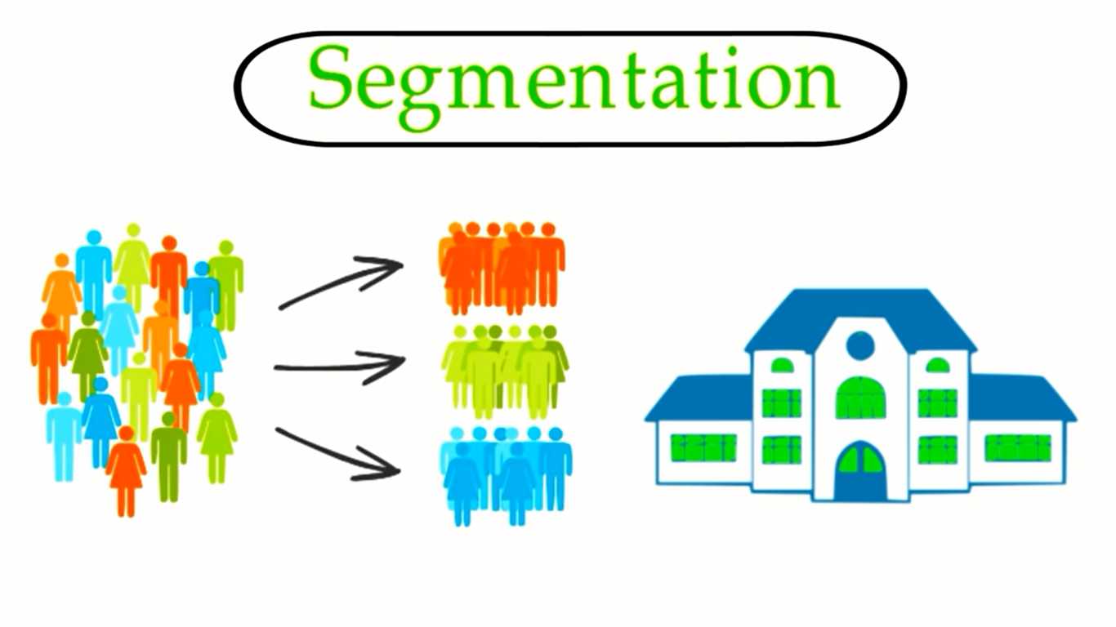
Market distribution

Slide 26
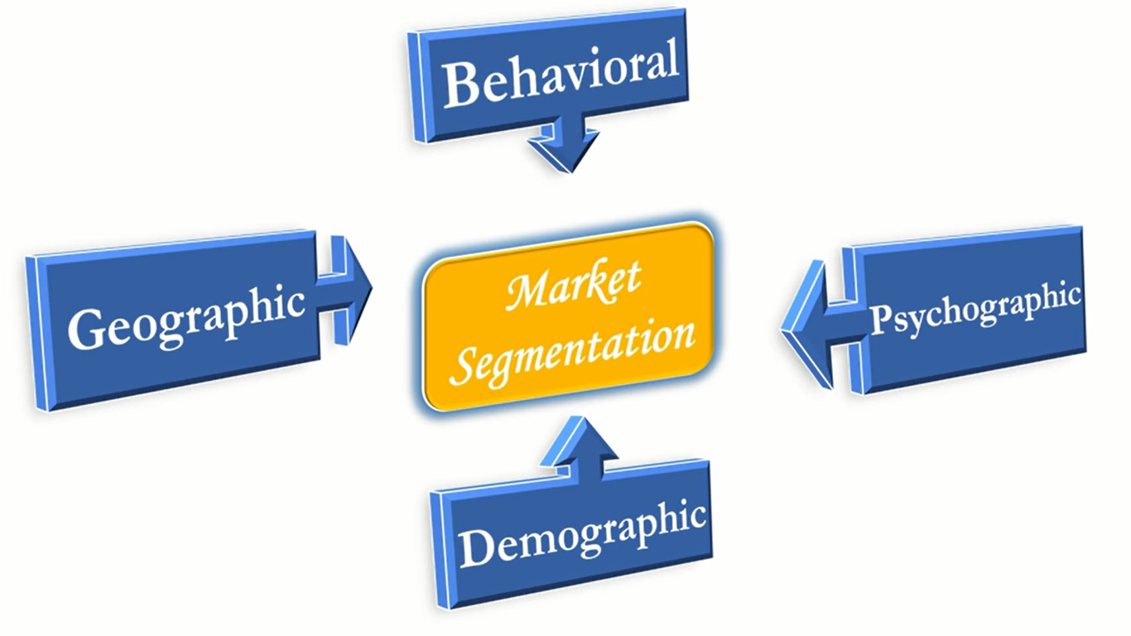

Slide 27
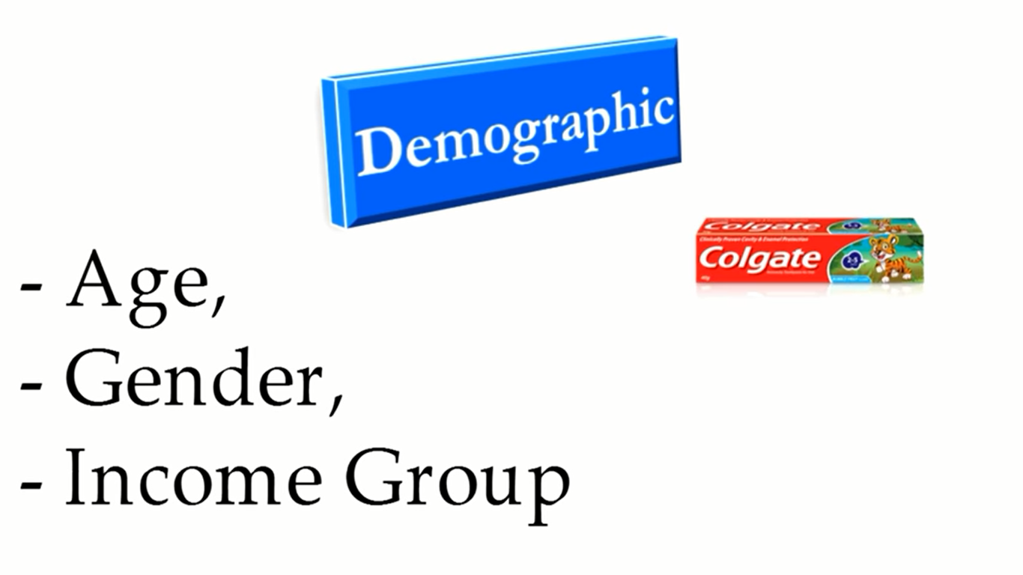

Slide 28
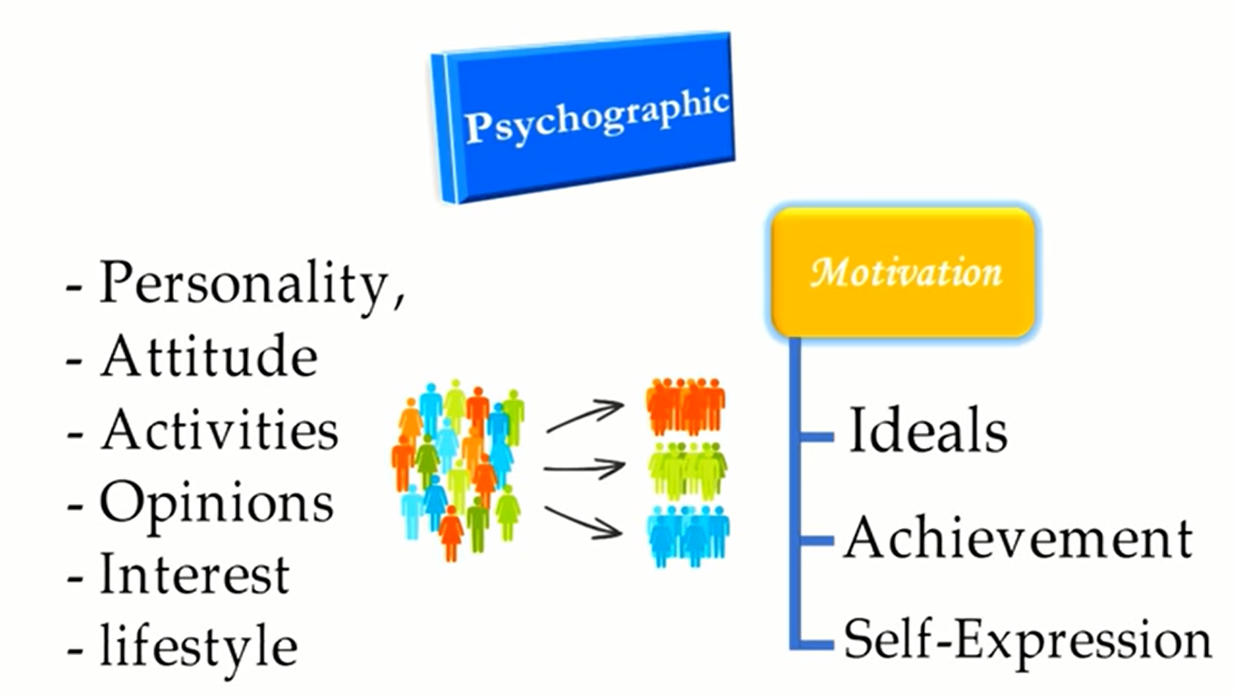

Slide 29
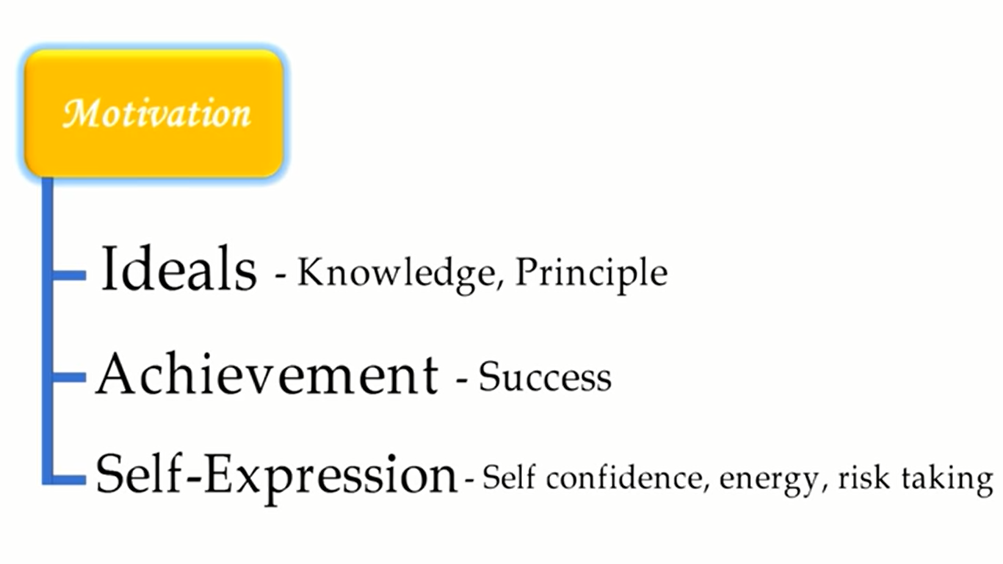

Slide 30
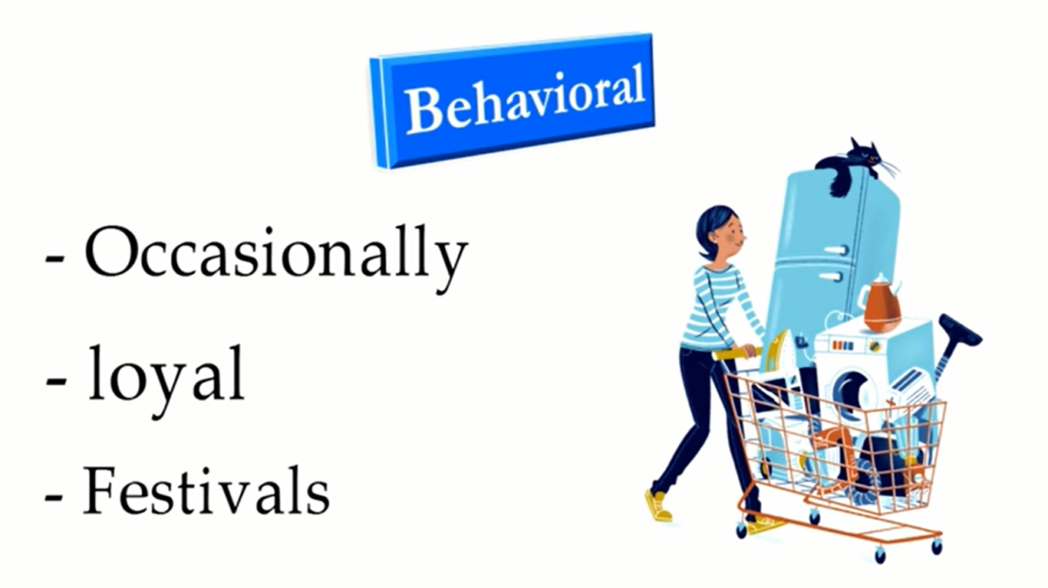

Slide 31
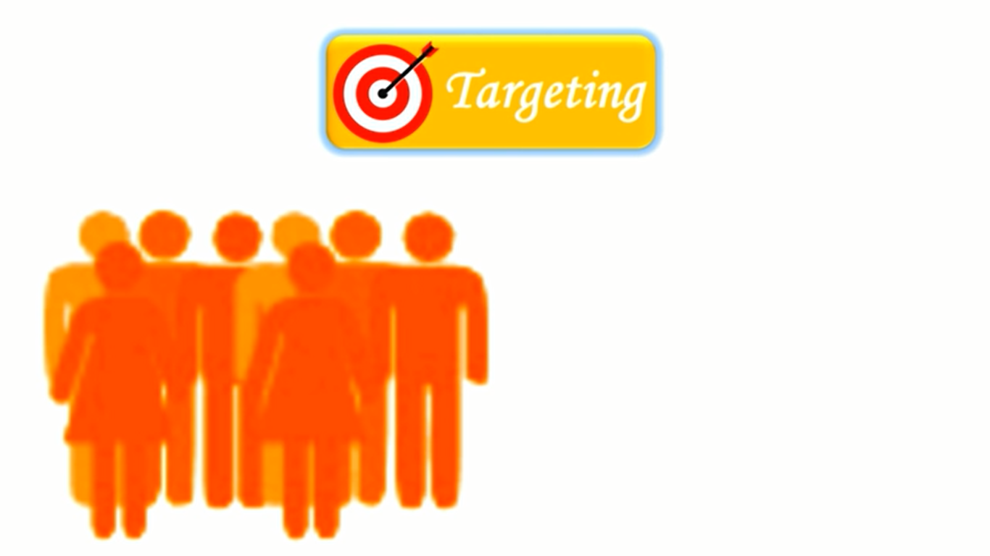
Targeting is the process of selecting a group within a larger group based on a set of criteria.

Slide 32
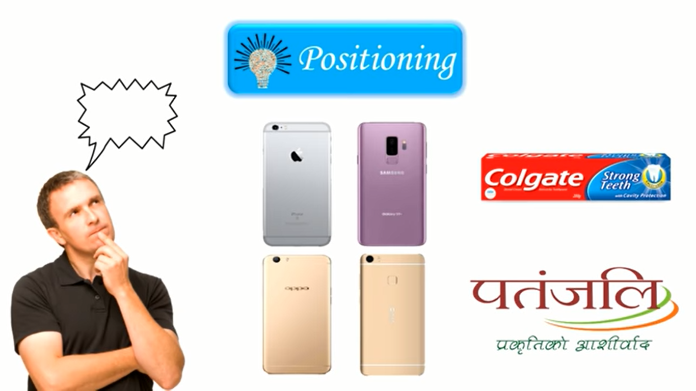
Positioning

Slide 33
What are the Marketing Concepts?
The marketing concept is a process when a company plans and implements to maximize profit by increasing sales, satisfying customer’s needs and beating competitors. The purpose is to create a situation that benefits both parties; customer and the company.
The idea of the marketing concept is to anticipate and satisfy the needs and wants of customers better than the competitors.

Slide 34
To fully understand the marketing concept, first, we have to understand needs, wants, and demands -
Needs – it is something necessary for the existence of life, many adverse things can happen without it. The worst-case scenario would be death. Needs comprises of many things; like food, shelter, security, social belonging, self-development, self-esteem, and respect.
Wants – wants are our wishes and desires that what we want in life, our social setup and culture shape our wants.
Demands – when our wishes, needs, and wants are backed by our capability to pay, then they become demands.

Slide 35
There are as many marketing concepts as many businesses running in the world. Some of those concepts exist today and the others have become obsolete.
There are five core marketing concepts also known as marketing management philosophies.

Slide 36
Marketing Concepts Explained
1) The production Concept – Products & companies were less.
2) The product Concept – High quality products demand,
3) Selling Concept – Based on approach to customer
4) Marketing concept – Focus on customer wants
5) Holistic Marketing Concept – Modern concept

Slide 37
Production Concept
The production concept is one of the earliest marketing concepts where the company focuses on the efficiency of its production processes. It is to produce the products cheaper to make it available to the mass population. The focus of the production concept is on the quantity, not the quality of the products.

Slide 38
Product Concept
The core idea of the product concept is to produce cheaper products because the customers won’t pay much price for the products or services. The companies that follow the product concept, manufacture the product on a mass scale and they make a profit out of the economies of the scale.
When businesses produce low-cost products, then they follow a vast distribution strategy to reach more audiences. By targeting more people, they can increase their productivity by expanding their market.

Slide 39
Selling Concept
As the name implies the idea of selling concept is to sell the company’s product through large scale marketing and promotional activities, it doesn’t whether they fulfill customers’ needs or not.
The focus of the management in this approach is to complete the transaction of sale; they think that their job is done once they sell their product. Instead of building and maintaining a long terms relationship with the customer, so the customer would come back again.

Slide 40
Marketing Concept
The marketing concept is customer-oriented. It puts customers in the middle of the marketing process, finding out customers’ needs and wants, then satisfying those needs better than the competitors.
In this approach, the marketer says that the customer is always right and his needs and wants should come first. Here the marketing strategy focuses on making a profit by meeting the needs and wants of customers.

Slide 41
a very simple strategy that marketers do not look for the right customers of their product; instead, they produce the right product for their customers. Marketers try to bridge the gap between the customers and the company’s products.

Slide 42
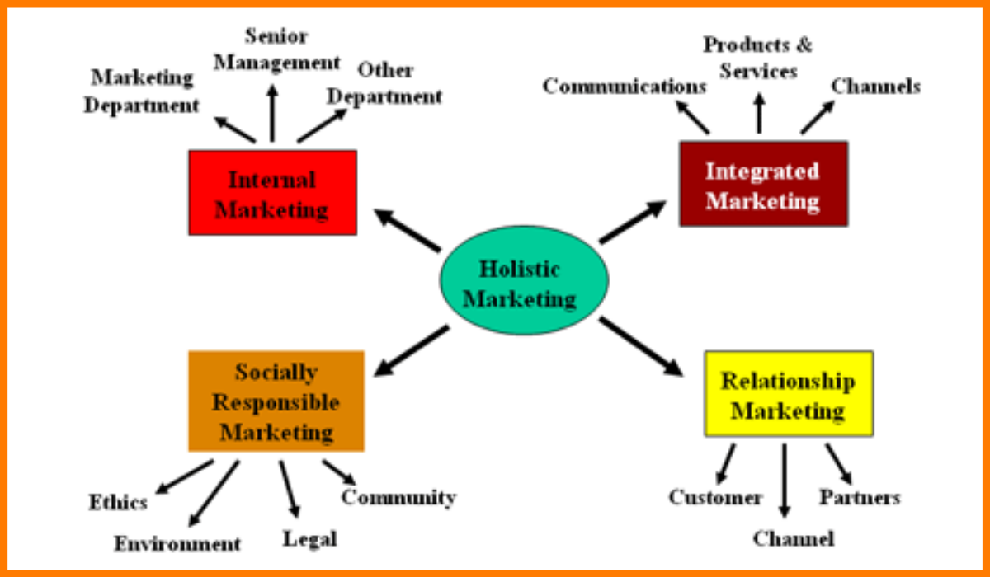
Holistic marketing concept

Slide 43
Approches
Internal marketing – Marketing between all the departments in an organization Relationship marketing – Building a better relationship with your customers, internal as well as end customers is beneficial for holistic marketing. Performance marketing – Driving the sales and revenue growth of an organization holistically by reducing costs and increasing sales. Integrated marketing – Products, services and marketing should work hand in hand towards to growth of the organization.

Slide 44
Defination
Holistic marketing concept is a part of the series on concepts of marketing and it can be defined as a marketing strategy which considers the business as a whole and not as an entity with various different parts.
According to holistic marketing concept, even if a business is made of various departments, the departments have to come together to project a positive & united business image in the minds of the customer. Holistic marketing concept involves interconnected marketing activities to ensure that the customer is likely to purchase their product rather than competition.

Slide 45
Example of Holistic marketing concept
An organization will have different departments like sales and marketing, accounting and finance, R&D and product development and finally HR and operations. Thus, if you want to implement a holistic marketing concept in your organization, you need to ensure that R&D and product development take the feedback from marketing and sales to launch the product which is most likely to attract customers.
On the other hand they need to work closely with accounting and finance to find out the exact budget for the project. Sales and marketing need to communicate to the HR the right kind of people that they need, and finally, admin and operations need to devise a plan to retain these people.

Slide 46
What Is Customer Relationship Management (CRM)?
Customer relationship management (CRM) refers to the principles, practices, and guidelines that an organization follows when interacting with its customers.
From the organization's point of view, this entire relationship encompasses direct interactions with customers, such as sales and service-related processes, forecasting, and the analysis of customer trends and behaviors. Ultimately, CRM serves to enhance the customer's overall experience.

Slide 47
The art of managing the organization’s relationship with the customers and prospective clients refer to customer relationship management.
Customer relationship management includes various strategies and techniques to maintain healthy relationship with the organization’s existing as well as potential customers. Orgnaizations must ensure customers are satisfied with their products and services for higher customer retention.
In simpler words, customer relationship management refers to the study of needs and expectations of the customers and providing them the right solution.

Slide 48
Need for Customer Relationship Management
Customer Relationship Management leads to satisfied customers and eventually higher business everytime.
Customer Relationship Management goes a long way in retaining existing customers.
Customer relationship management ensures customers return back home with a smile.
Customer relationship management improves the relationship between the organization and customers. Such activities strengthen the bond between the sales representatives and customers.

Slide 49
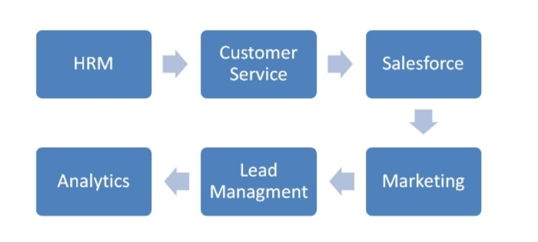
Components of CRM

Slide 50
HRM- Human resource management.-An effective people strategy and reducing attrition rate goes a long way in increasing the efficiency of the workforce. Proper policies in place and effective implementation are the key factors here.
Customer service- This not only develops a healthy relationship with the customers, but a good servitization strategy also adds to different revenue models for the business. Along with that, the data obtained gives us an idea of customer purchase patterns, helps in inventory modeling, and eliminating supply chain bottlenecks.
Sales force- Sales forecasting, processing, and tracking potential interactions help in business development and lead generation. It gives revenue generation opportunities and helps analyze the performance of the workforce.

Slide 51
Marketing- Promotional strategies, campaign management, and integrated media communications, including digital and offline campaigns, can all be improved and implemented well through effective usage of CRM.
Lead management- This helps in keeping a track of sales leads and distribution. This provides enough forecast data for production and inventory managers along with helping distributors scale-up in eliminating logistic bottlenecks.
Analytics- Corporate level decisions are made based on the data submitted by functional level and business level heads. Graphs, plots, and trends are collected that helps make predictions for business growth and prosperity.

